Slide 1

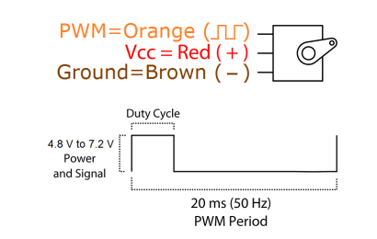
Servo
Rotation range: 120 degree (60 in each direction)
Weight: 55g
Dimension: 40.7 * 19.7 * 42.9mm
Stall torque: 8.5 Kgf·cm(4.8V), 10 Kgf·cm(6V)
Operating speed: 0.2 s/60°(4.8V), 0.16 s/60°(6V)
Operating voltage: 4.8 ~ 7.2V
Temperature range: 0℃ ~ 55 ℃

Slide 2
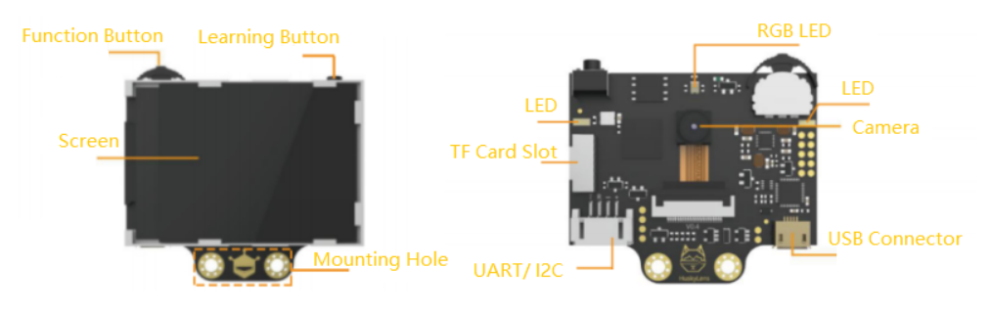
HuskyLens
HuskyLens only learned one plane (one-dimensional) of the face, So it’s necessary to let HuskyLens learn a face from different angles.

Slide 3
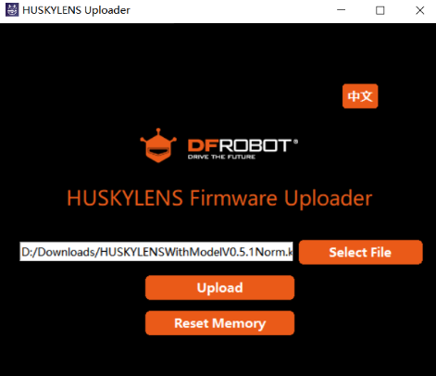
Download HUSKYLENS Uploader software.
https://img.dfrobot.com.cn/wiki/5a93d3cc01cd38236f596279/95a46f8f363fe8a9ddc6727301e07337.zip
Download and install driver.
https://cn.silabs.com/developers/usb-to-uart-bridge-vcp-drivers
Download firmware v0.5.1a.
https://img.dfrobot.com.cn/wiki/5a93d3cc01cd38236f596279/ecd6cfe3c9ad2388c1867a141d547045.zip
Run HUSKYLENS Uploader V2.1, click “Select File” button to upload the firmware.

Slide 4
Set HuskyLens
Click function button, turn the button right to select <General Setting>, <Protocol Type>, <I2C>.
Then save & return the data
Select <Face Recognition>
Keep pressing the “learning button”, point "+" symbol at different angles of the face. During this process, a yellow frame with words "Face: ID1" will be displayed on the screen. Please point the yellow frame at different angles of the same person's face to enter all angles of this person's face. Then you can release the "learning button" to finish the learning.
Click learning button to forget

Slide 5

Set Arduino
Download Arduino IDE
https://www.arduino.cc/en/software
Download library from github
https://github.com/DFRobot/DFRobot_MAX
Set <Tool>--<“board:Arduino Uno”> and <Port>--<find your port number in device manager>

Slide 6
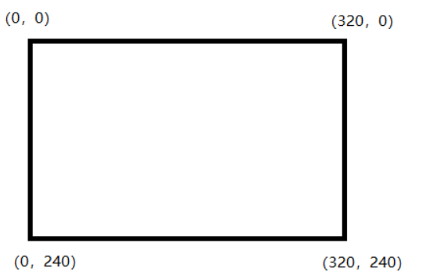
Coordinate

Slide 7
HUSKYLENS Arduino API
https://github.com/HuskyLens/HUSKYLENSArduino

